Slide 1



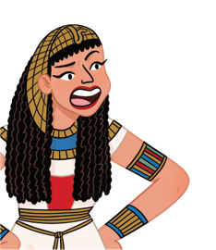

Slide 2

During the Stone Age, humans were hunter-gatherers.

Slide 3

In the Stone Age, humans spent a lot of time hunting animals and fish and gathering, fruit, nuts and seeds, to eat.

Slide 4
The French emperor, Napoleon was a short man.

Slide 5

Napoleon was famous for being short, but this was a lie spread by the British. He was actually around the average height for a man of the time!

Slide 6
Christopher Columbus discovered America.

Slide 7
This was a big lie.
Christopher Columbus only reached the Caribbean and some of South America, where people were living anyway!

Slide 8
The Egyptians worshipped over 2,000 gods and goddesses!

Slide 9
Gods and goddesses were a very important part of Egyptian life, and cats were considered especially divine.

Slide 10
Marie Antoinette said, ‘Let them eat cake!’

Slide 11
Marie Antoinette was known for being very extravagant and very unpopular, but this was a lie made up to make her even more unlikeable.

Slide 12
When he died, Albert Einstein’s brain was removed and preserved to be studied!

Slide 13
Thin slices of Einstein’s brain are currently on display in the Mütter Museum in Philadelphia.

Slide 14
King Arthur is buried at Glastonbury Abbey.

Slide 15
The monks and nuns at Glastonbury Abbey lied about finding King Arthur’s bones to attract pilgrims.

Slide 16
The richest athlete who ever lived was a Roman chariot racer.

Slide 17
His name was Gaius Appuleius Diocles, and in today’s money, his winnings would be worth hundreds of millions of pounds!

Slide 18


