Slide 1

ASSEMBLY FOR . . .
SUBJECT/THEME: RSHE | EMBRACING CHANGE
FOR KS2/KS3
AGES 11+
GO BIG: THE SECONDARY SCHOOL SURVIVAL GUIDE
By Matthew Burton

Slide 2

WORD ASSOCIATION: WHAT DO THESE WORDS MEAN TO YOU?
SAY THE FIRST THING THAT COMES TO MIND
PRIMARY SCHOOL
SECONDARY SCHOOL
UNIFORM
EXAMS
CHANGE

Slide 3
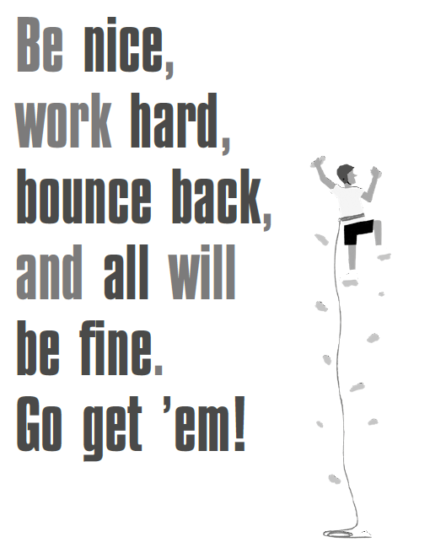
TRANSITIONS
DISCUSS WITH A PARTNER …
What is a ‘transition’?
What does the quote on the left mean to you?

Slide 4
You should be
YOURSELF.
'Normal' is a clear, shiny paint people put on things to keep us feeling okay. It’s the version of ourselves that gets shown to the outside world. Everyone’s version of that is different.
EMBRACE YOUR WEIRDNESS
It’s tempting to try to try to just ‘blend in’ and ‘be normal’ but as
Mr Burton says …

Slide 5
A NEW SCHOOL MEANS NEW PEOPLE!
DISCUSS AS A CLASS …
1) What might you have in common with your new classmates?
2) What differences might you have?

Slide 6
Close your eyes and picture a school in which everyone looks, talks, and thinks exactly the same.
DISCUSS WITH A PARTNER …
What would change? How would it feel? What would you lose?

Slide 7
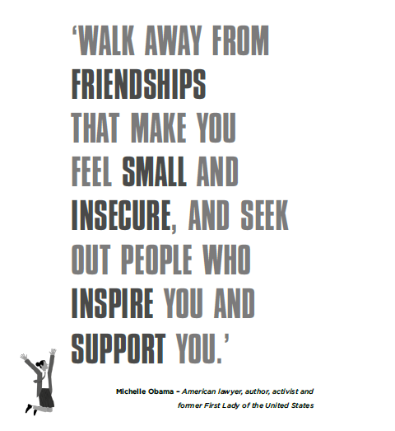
FRIENDSHIPS AND FALLOUTS

Slide 8
FINISH THESE SENTENCES WITH A PARTNER …
A good friend should …
A real friend always ...
A true friend tries to ...
A close friend should never ...
FRIENDS ARE IMPORTANT BUT NOMATTER WHAT, AS MR BURTON SAYS,
live your own life and do what makes you wear a smile.

Slide 9

LEAPING INTO THE FUTURE

Slide 10
DISCUSS TOGETHER:
Why is fear so difficult to deal with?
How does fear make you feel?
What does fear make you do?
How can you channel your fear into something positive?
THEN, RANK THESE FEARS FROM 1–10 (1 BEING THE MOST SCARY!)
SPIDERS EXAMS HOMEWORK TEACHERS
HEIGHTS BEING LATE BAD HAIR DAY
CHANGE BEING BULLIED LOSING YOUR PHONE

Slide 11
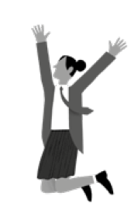
Before you go, make yourself a promise that will help you make the transition from primary to secondary school. It might be to do with one of today’s themes:
TRANSITIONS
EMBRACING YOUR WEIRDNESS
FRIENDSHIPS AND FALLOUTS
LEAPING INTO THE FUTURE
YOU GOT THIS!

